Slide 1
Notes:
Topics:
Introduction to Functions
Defining and Calling a Void Function
Designing a Program to Use Functions
Local Variables
Passing Arguments to Functions
Global Variables and Global Constants
Introduction to Value-Returning Functions: Generating Random Numbers
Writing Your Own Value-Returning Functions
The math Module
Storing Functions in Modules

Slide 2
Introduction to Functions
Function: group of statements within a program that perform as specific task
Usually one task of a large program
Functions can be executed in order to perform overall program task
Known as divide and conquer approach
Modularized program: program wherein each task within the program is in its own function
Notes:
Most programs perform tasks that are large enough to be broken down into several subtasks. For this reason, programmers usually break down their programs into small manageable pieces known as functions. Instead of writing a large program as one long sequence of statements, it can be written as several small functions, each one performing a specific part of the task. These small functions can then be executed in the desired order to perform the overall task. This approach is sometimes called divide and conquer because a large task is divided into several smaller tasks that are easily performed.

Slide 3
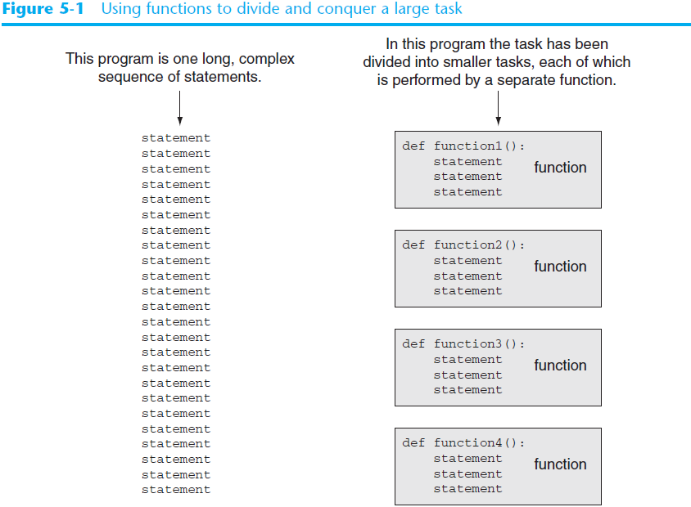
Notes:
Figure compares two programs: one that uses a long complex sequence of statements to perform a task, and another that divides a task into smaller tasks, each of which is performed by a separate function.

Slide 4
Benefits of Modularizing a Program with Functions
The benefits of using functions include:
Simpler code
Code reuse
Write the code once and call it multiple times
Better testing and debugging
Can test and debug each function individually
Faster development
Easier facilitation of teamwork
Different team members can write different functions

Slide 5
Void Functions and Value-Returning Functions
A void function:
Simply executes the statements it contains and then terminates
A value-returning function:
Executes the statements it contains, and then it returns a value back to the statement that called it
The input, int, and float functions are examples of value-returning functions
Notes:
In this chapter, you will learn to write two types of functions: void functions and value-returning functions. When you call a void function, it simply executes the statements it contains and then terminates. When you call a value-returning function, it executes the statements that it contains, then returns a value back to the statement that called it. The input function is an example of a value-returning function. When you call the input function, it gets the data that the user types on the keyboard and returns that data as a string. The int and float functions are also examples of value-returning functions. You pass an argument to the int function, and it returns that argument’s value converted to an integer. Likewise, you pass an argument to the float function, and it returns that argument’s value converted to a floating-point number.

Slide 6
Defining and Calling a Function
Functions are given names
Same rules apply to naming functions as naming variables
Function name should be descriptive of the task carried out by the function
Often includes a verb
Function definition: specifies what function does
def function_name():
statement
statement
Function header
Block
Notes:
Function header: first line of function
-- Includes keyword def and function name, followed by parentheses and colon
Block: set of statements that belong together as a group
-- Example: the statements included in a function

Slide 7
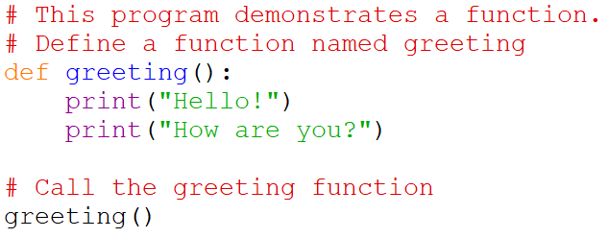

Defining and Calling a Function (cont’d.)
Call a function to execute it
Example program:
Output:
Notes:
When a function is called
-- Interpreter jumps to the function and executes statements in the block
-- Interpreter jumps back to part of program that called the function (known as function return)
The parameters are always listed in parenthesis. There are no parameters for this function so the parameter list is empty.

Slide 8
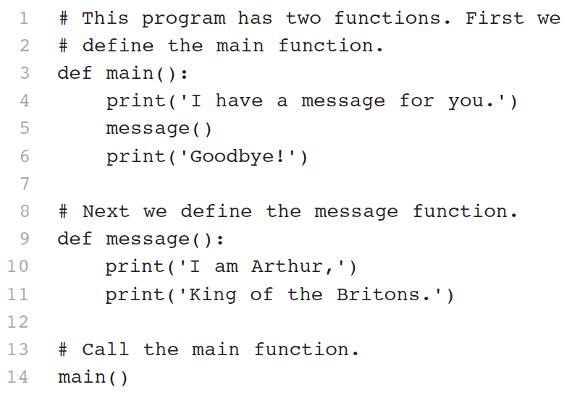
Defining and Calling a Function (cont’d.)
main function: called when the program starts
Calls other functions when they are needed
Defines the mainline logic of the program
Notes:
Mainline logic, which is the overall logic of the program
Each block must be indented
Lines in block must begin with the same number of spaces
-- Use tabs or spaces to indent lines in a block, but not both as this can confuse the Python interpreter
-- IDLE automatically indents the lines in a block
Blank lines that appear in a block are ignored

Slide 9
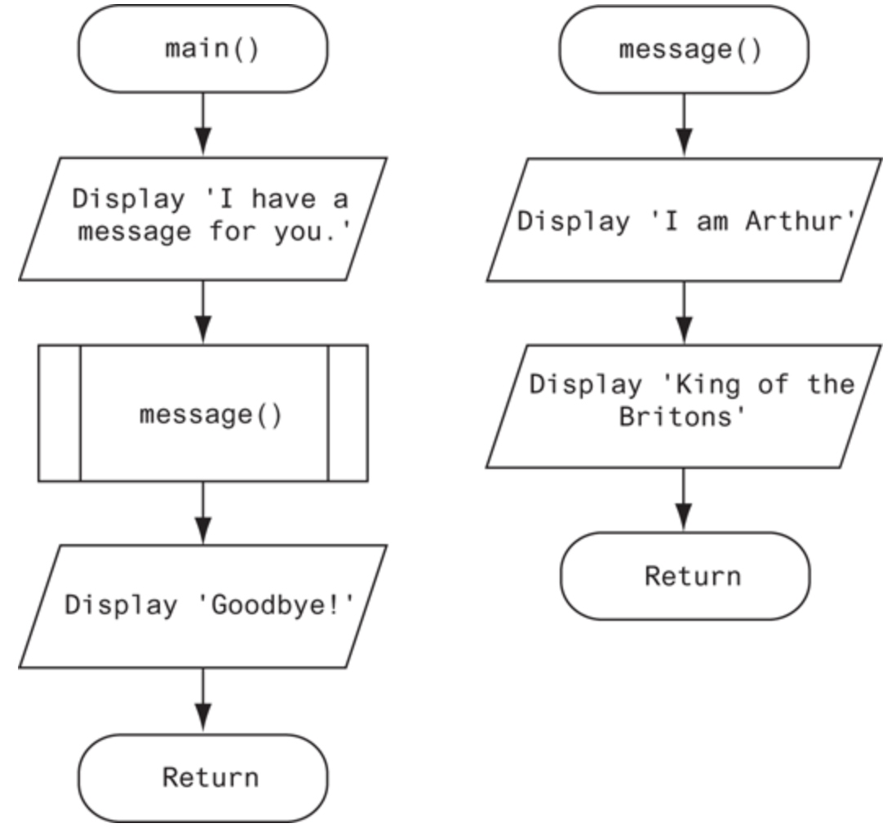
Designing a Program to Use Functions
In a flowchart, function call shown as rectangle with vertical bars at each side
Function name written in the symbol
Typically draw separate flow chart for each function in the program
End terminal symbol usually reads Return

Slide 10
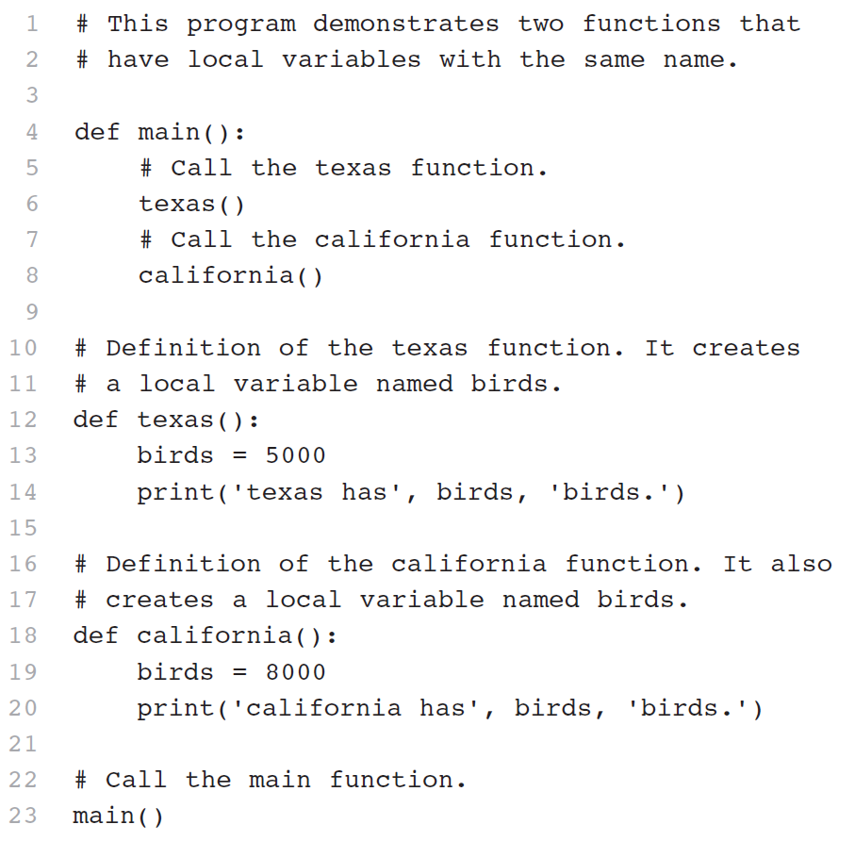
Local Variables
Local variable: variable that is assigned a value inside a function
Different functions may have local variables with the same name
Notes:
Anytime you assign a value to a variable inside a function, you create a local variable.
Local variable: Belongs to the function in which it was created; Only statements inside that function can access it, error will occur if another function tries to access the variable
Local variable cannot be accessed by statements inside its function which precede its creation
Each function does not see the other function’s local variables, so no confusion

Slide 11
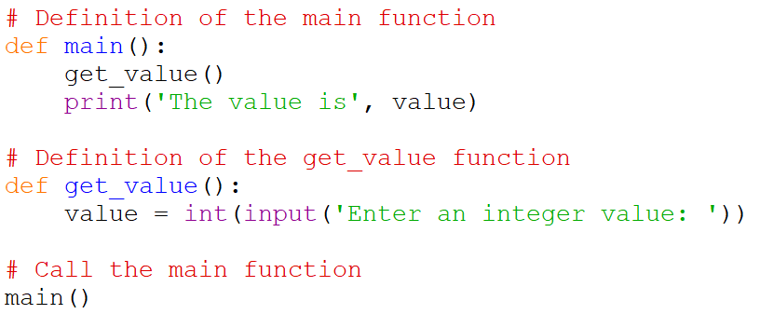
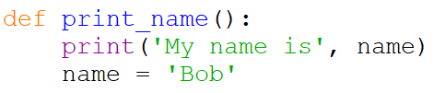
Knowledge Check
1. What is wrong with this program?
2. What is wrong with this function?
Notes:
The value variable is local to get_value so it cannot be accessed by statements outside of the get_value function. Thus, the main function cannot access the value variable.
The print function tries to access the name variable but this statement appears before the name variable has been created. Moving the assignment statement to a line before the print statement will fix this error.

Slide 12
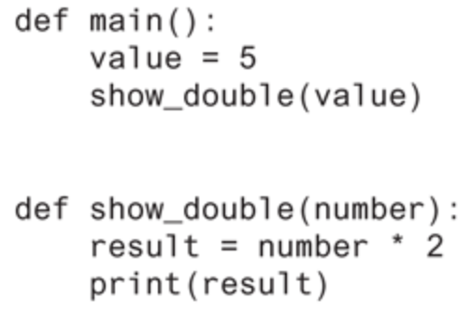
Passing Arguments to Functions
Argument: piece of data that is sent into a function
Parameter: variable that is assigned the value of an argument when the function is called
Argument
Parameter
Notes:
Function can use argument in calculations
When calling the function, the argument is placed in parentheses following the function name
The parameter and the argument reference the same value
General format: def function_name(parameter):
Most of the time you don’t want the function to do the same thing over and over. You want it to run the same algorithm using different data.

Slide 13
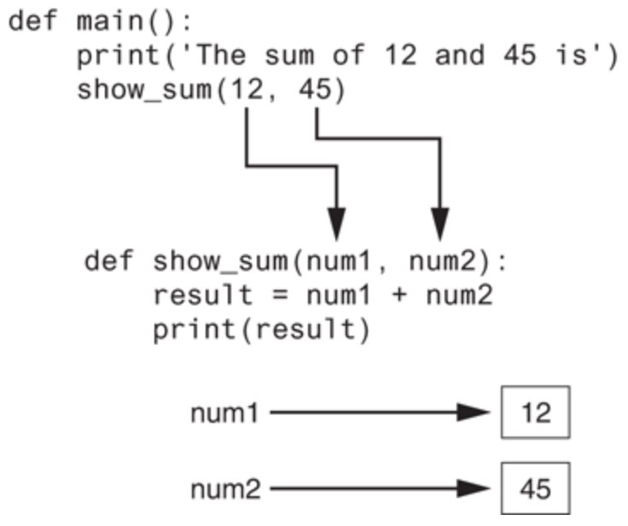
Passing Multiple Arguments
Python allows writing a function that accepts multiple arguments
Arguments are passed by position to corresponding parameters
Notes:
Parameter list replaces single parameter
Parameter list items separated by comma
Passed by position: First parameter receives value of first argument, second parameter receives value of second argument, etc.

Slide 14
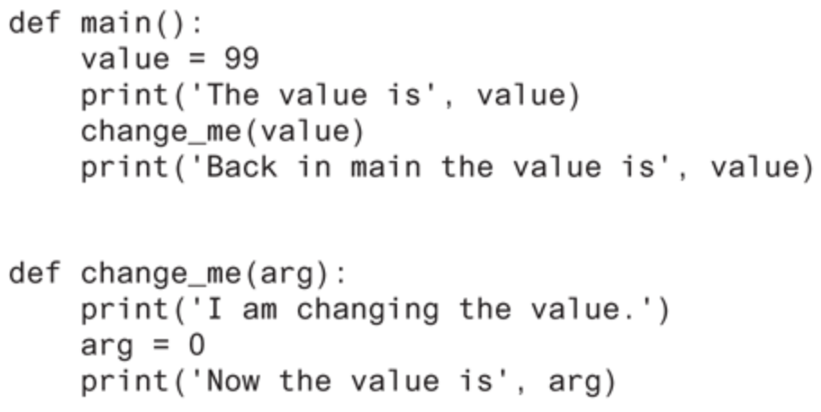
Making Changes to Parameters
Changes made to a parameter value within the function do not affect the argument
Known as pass by value
Notes:
Provides a way for unidirectional communication between one function and another function
Calling function can communicate with called function
The value variable passed to the change_me function cannot be changed by it

Slide 15
Keyword Arguments
Keyword argument: argument that specifies which parameter the value should be passed to
Position when calling function is irrelevant
General Format:
function_name(parameter=value)
Possible to mix keyword and positional arguments when calling a function
Positional arguments must appear first
Notes:
This is okay: show_interest(10000.0, rate=0.01, periods=10)
A non-keyword argument cannot follow a keyword argument – Ex: show_interest(1000.0, rate=0.01, 10)

Slide 16
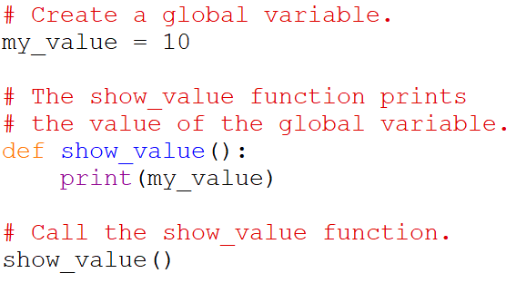
Global Variables and Global Constants
Global variable: created by assignment statement written outside all the functions
Can be accessed by any statement in the program file, including from within a function
Notes:
A global variable is accessible to all the functions in a program file.

Slide 17
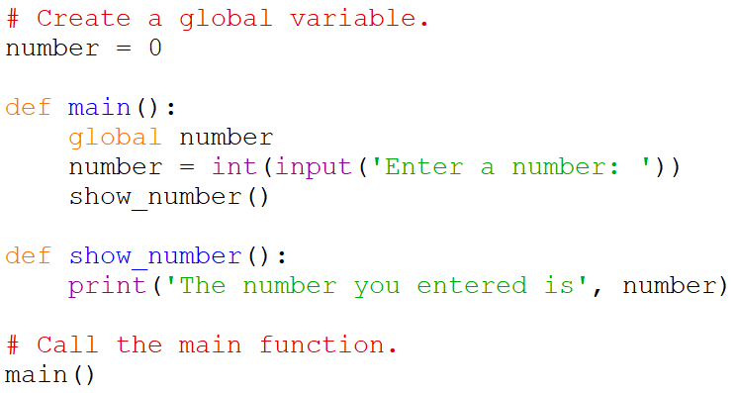
Global Variables and Global Constants (cont’d.)
If a function needs to assign a value to the global variable, the global variable must be redeclared within the function
General format: global variable_name

Slide 18
Global Variables and Global Constants (cont’d.)
Generally, you should avoid or limit use of global variables
Why?
Global variables making debugging difficult
Functions that use global variables are usually dependent on those variables
Global variables make a program hard to understand
Global constant: global name that references a value that cannot be changed
Notes:
Global variables make debugging difficult: Many locations in the code could be causing a wrong variable value
Functions dependent on global variables: Makes function hard to transfer to another program
Global constant: (like named constants)
Permissible to use global constants in a program
To simulate global constant in Python, create global variable and do not re-declare it within functions

Slide 19
Introduction to Value-Returning Functions
void function: group of statements within a program for performing a specific task
Call function when you need to perform the task
Value-returning function: similar to void function, returns a value
Value returned to part of program that called the function when function finishes executing

Slide 20
Standard Library Functions and the import Statement
Standard library: library of pre-written functions that comes with Python
Examples of built-in functions: print, input, range
Modules: files that store functions of the standard library
Help organize library functions not built into the interpreter
To call a function stored in a module, need to write an import statement
Written at the top of the program
Format: import module_name
Notes:
Library functions perform tasks that programmers commonly need

Slide 21
Modules
math module: part of standard library that contains functions that are useful for performing mathematical calculations
Use of module requires an import math statement
random module: includes library functions for working with random numbers
Use of module requires an import random statement
Notes:
Math module: Typically accepts one or more values as arguments, perform mathematical operation, and return the result

Slide 22
Dot Notation
Dot notation: notation for calling a function belonging to a module
Format: module_name.function_name()
Examples:
number = math.sqrt(81)
number = random.randint(1, 100)
number = random.randrange(10)
number = random.randrange(5, 10)
number = random.randrange(0, 101, 10)
number = random.random()
number = random.uniform(1.0, 10.0)
Notes:
randint function: generates a random number in the range provided by the arguments
Returns the random number to part of program that called the function
Returned integer can be used anywhere that an integer would be used
randrange function: similar to range function, but returns randomly selected integer from the resulting sequence
Same arguments as for the range function
random function: returns a random float in the range of 0.0 and 1.0
Does not receive arguments
uniform function: returns a random float but allows user to specify range

Slide 23
Random Number Seeds
Random number created by functions in random module are actually pseudo-random numbers
Seed value: initializes the formula that generates random numbers
Need to use different seeds in order to get different series of random numbers
By default uses system time for seed
Can use random.seed() function to specify desired seed value

Slide 24
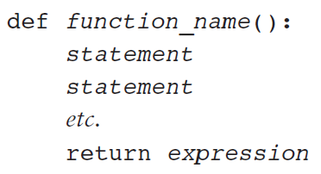
Writing Your Own Value-Returning Functions
To write a value-returning function, you write a simple function and add a return statement
Format:
Notes:
The value for expression will be returned to the part of the program that called the function
The expression in the return statement can be a complex expression, such as a sum of two variables or the result of another value- returning function

Slide 25
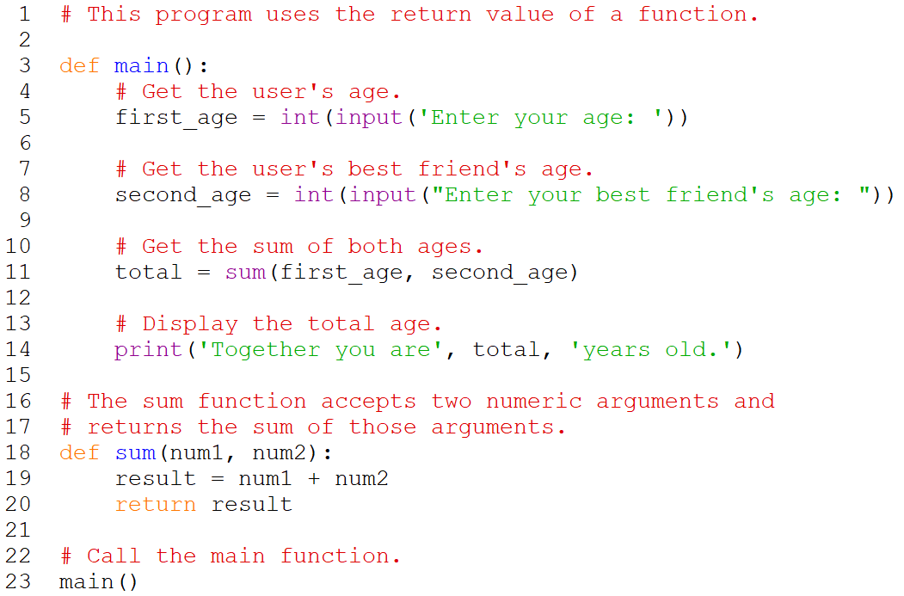
Value-Returning Function Example
Notes:
The sum function can be rewritten as:
def sum(num1, num2):
return num1 + num2

Slide 26
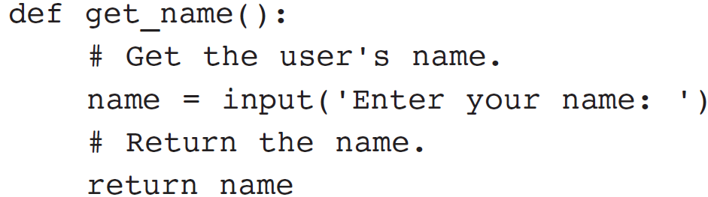
Returning Strings
You can write functions that return strings
For example:

Slide 27
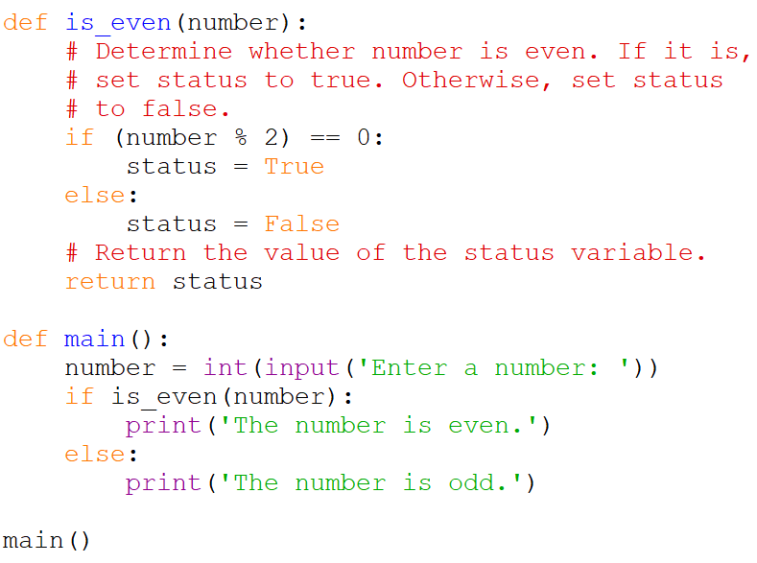
Returning Boolean Values
Boolean function: returns either True or False
Useful for simplifying conditions tested in decision and repetition structures
Notes:
Common calculations, such as whether a number is even, can be easily repeated by calling a function
Use to simplify complex input validation code

Slide 28
Returning Multiple Values
In Python, a function can return multiple values
Specified after the return statement separated by commas
Format: return expression1,
expression2, etc.
When you call such a function in an assignment statement, you need a separate variable on the left side of the = operator to receive each returned value

Slide 29
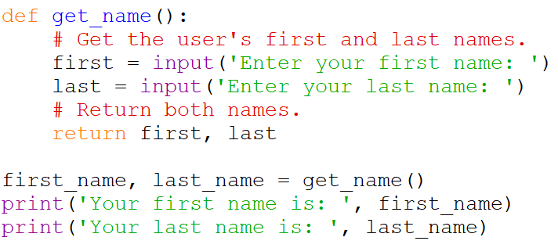
Returning Multiple Values Example

Slide 30
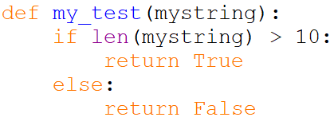
Knowledge Check
Look at the following function definition:
A) What is the name of the function?
B) What does the function do?
C) Given the function definition, what will the following statement display?
Notes:
my_test
Test string to see if it is greater than 10 characters or not
True

Slide 31
Summary
This chapter covered:
The advantages of using functions
The syntax for defining and calling a function
Methods for designing a program to use functions
Use of local variables and their scope
Syntax and limitations of passing arguments to functions
Global variables, global constants, and their advantages and disadvantages

Slide 32
Summary (cont’d.)
Value-returning functions, including:
Writing value-returning functions
Using value-returning functions
Functions returning multiple values
Using library functions and the import statement
Modules, including:
The random and math modules

Slide 33
In-class Exercise 4
Write a function that takes two parameters – a protein sequence and an amino acid residue code¹ – and returns the percentage of the protein that the amino acid makes up. The main function should take user input for the protein sequence and amino acid residue code and pass these values to the function. The main function should also print out the percentage returned by the function.
¹ https://en.wikipedia.org/wiki/Protein_primary_structure

